Slide 1
Reservation - Calling
Python project
Ibohim Bahromov – 14012656
Oybek Toshmatov – 14012688
Alisher Ermatov – 14012665
Javlon Umrzokov – 14012691

Slide 2
Application provides functionality
to make reservations for
Reastaurants, Offices and
School and University facilities

Slide 3
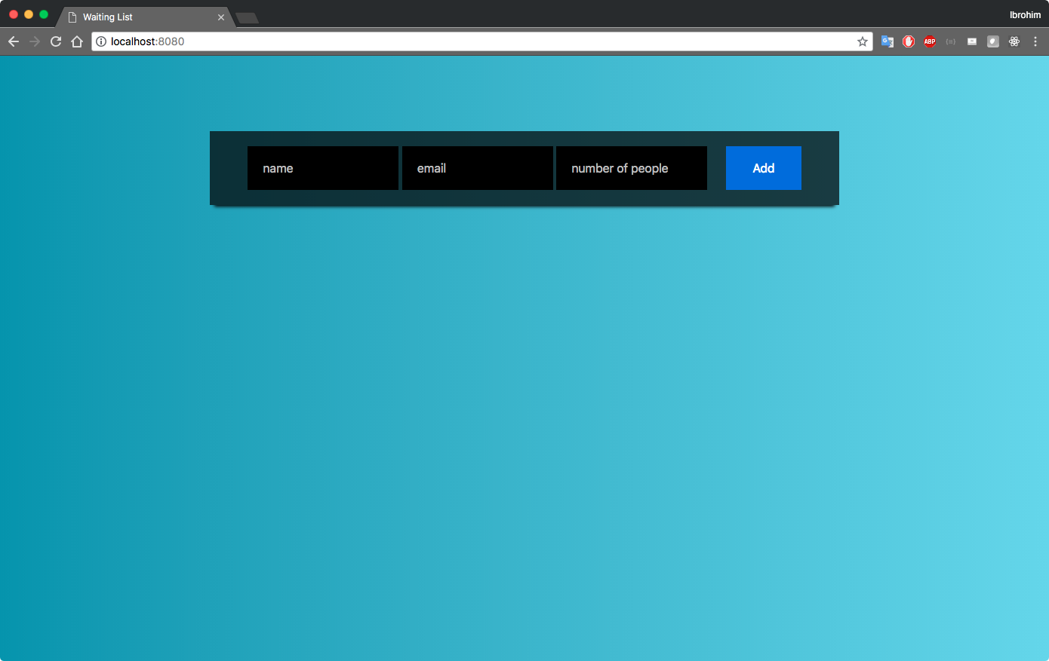

Slide 4
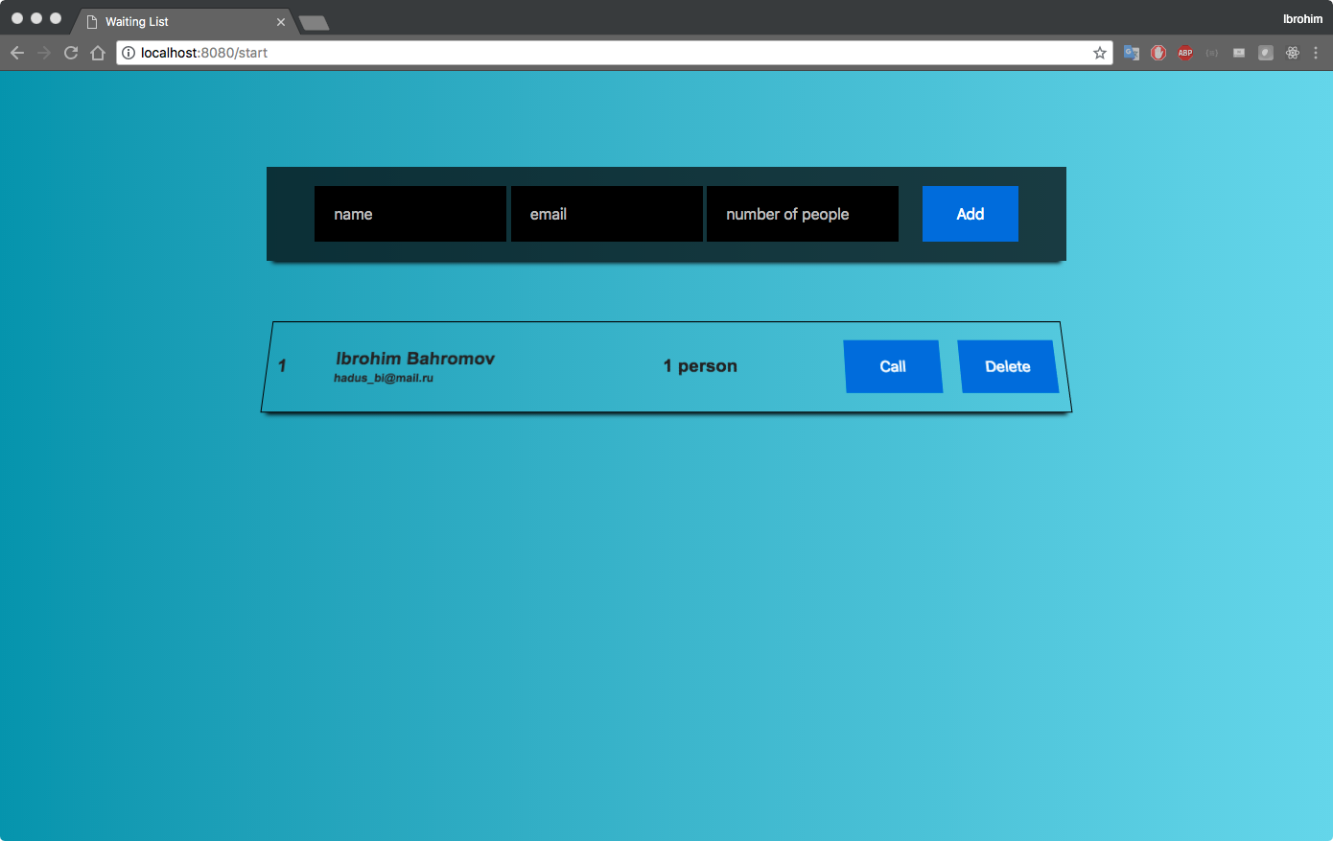

Slide 5
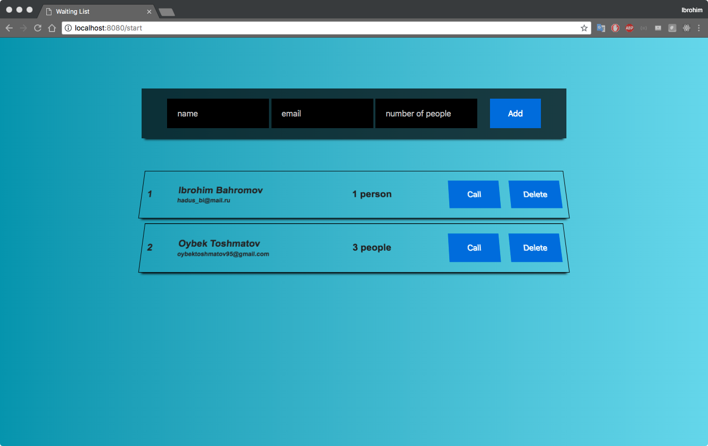

Slide 6
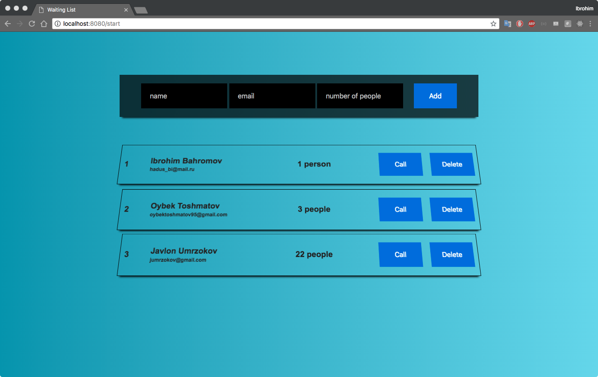

Slide 7
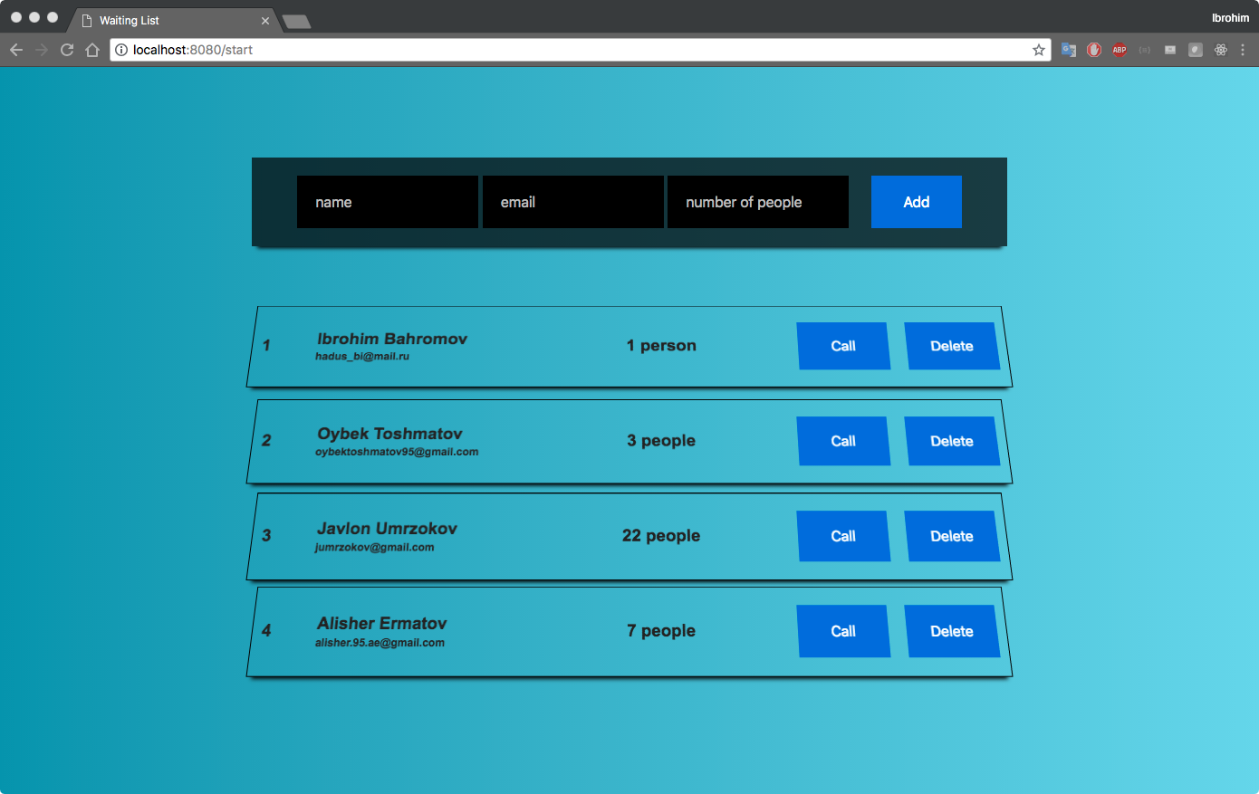

Slide 8
Python
- Variable
- List
- Dictionary
- Functions
- Loops
Bottle
Smtplib
Python Template
- Html
- Css

Slide 9
from bottle import *
@route(‘/’, method=”POST”)
@view(index)
def foo():
#todo

Slide 10
from smtplib import *
server = smtplib.SMTP(‘server’, port_number)
server.starttls()
server.login(”someone@gmail.com", ”password")
server.sendmail(“from@gmail.com”, “to@gmail.com”, email_body)

Slide 11
%
<p>{{data.header}}</p>
for i in range(len(data)):
<p>{{data.item}}</p>
% end

Slide 12
print(”Thank you”)

